Slide 1

PSoC6 WIFI Hands On Training

Slide 2
Connect to WPA2 Wi-Fi network

Slide 3
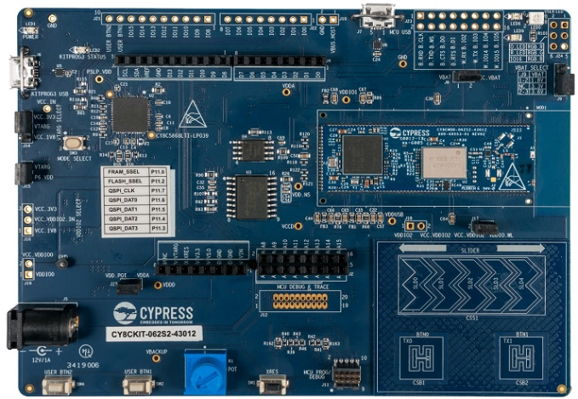
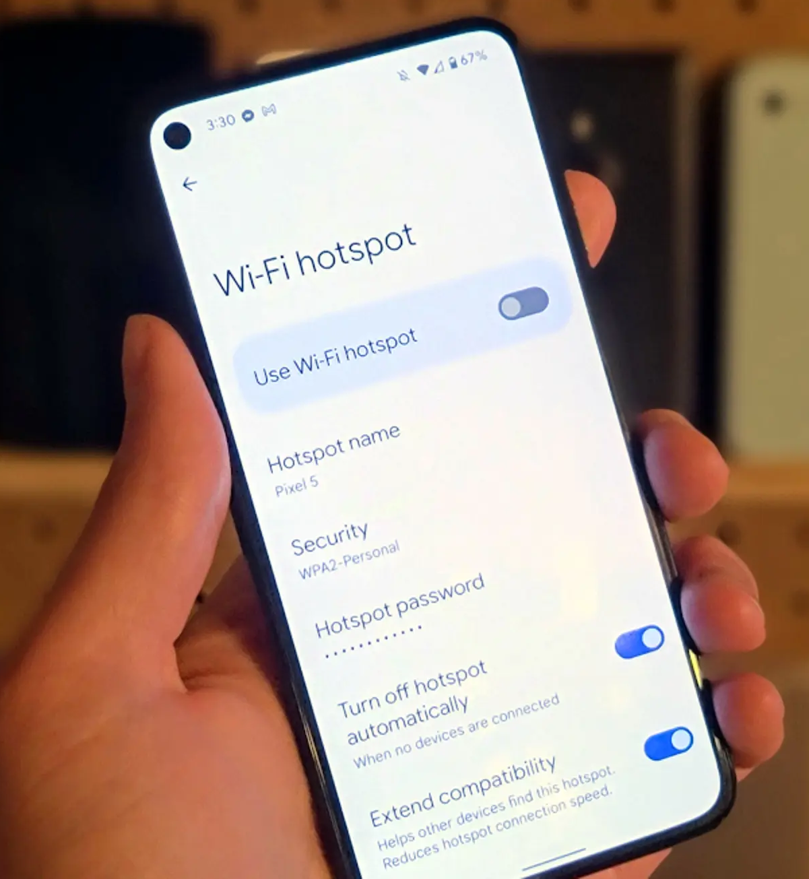

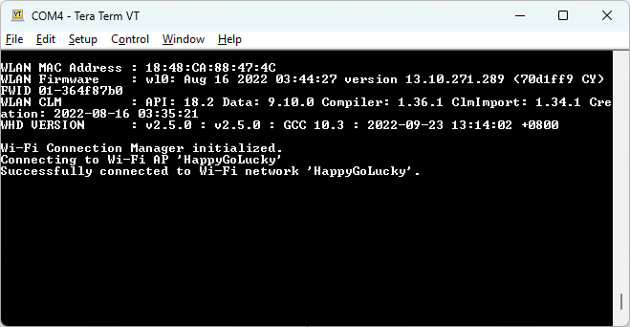
Objective
Wi-Fi Access Point
Create an App from an empty template that attaches to a WPA2 AES PSK network, have LED1 turn on for success and blink for a failure.
Objective is to understand what are the libraries and APIs needed for a simple Wi-Fi connection.
Connection update to PC

Slide 4
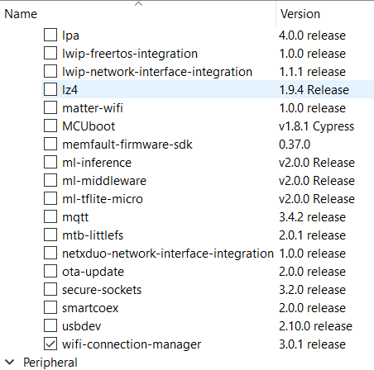
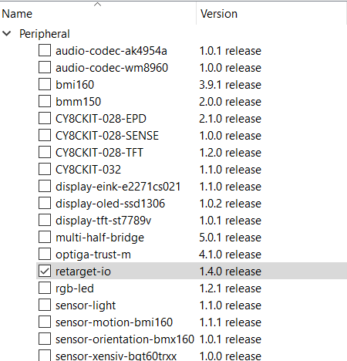
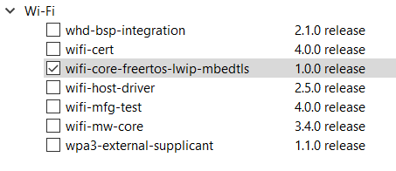
Create App and add Library
Create a new application named WiFi_Connect based on the Empty_PSoC6_App template.
Open the Library manager and add
Middleware >> wifi-connection-manager
Peripheral >> retarget-io libraries
Wi-Fi >> wifi-core-freertos-lwip-mbedtls.
b
a
c

Slide 5
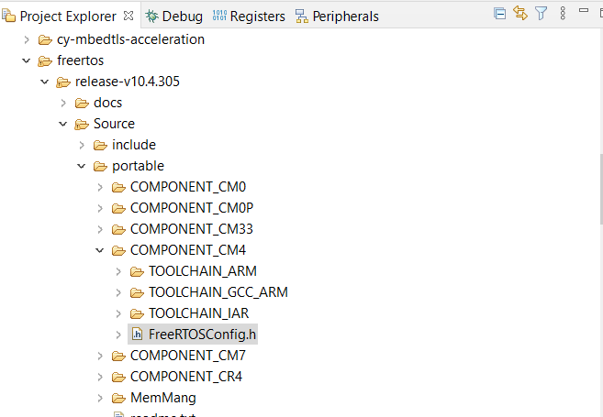
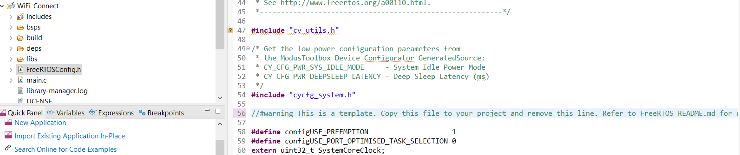
Copy and Edit files
Copy FreeRTOSConfig.h from mtb_shared/freertos/release-vX.X.X/Source/portable/COMPONENT_CM4 to your project root directory.
Open this file and delete the line that starts with #warning.
1
2

Slide 6
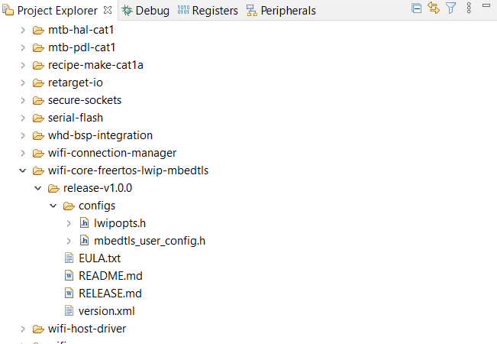
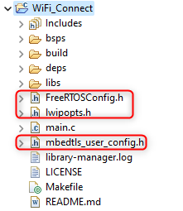

Copy and Edit files
Copy the files from the mtb_shared/wifi-core-freertos-lwip-mbedtls/release-vX.X/configs directory to your root project directory. The files are:
lwipopts.h
mbedtls_user_config.h
Open the mbedtls_user_config.h file and verify that the following line is not commented out:
#define MBEDTLS_NO_PLATFORM_ENTROPY

Slide 7
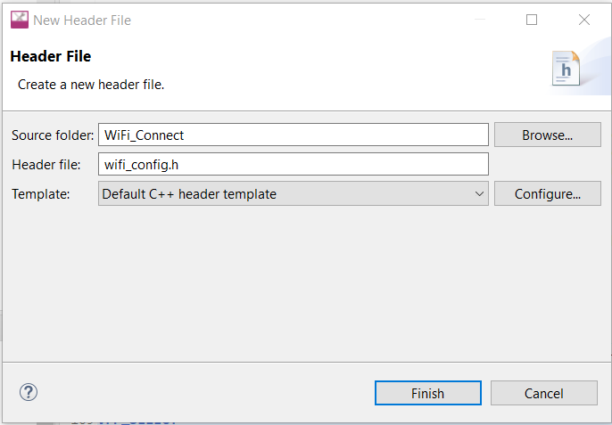
Create a file wifi_config.h
Copy the following code into a new header file called wifi_config.h
Edit WIFI_SSID and WIFI_PASSWORD to join to your AP (mobile hot spot)
#define WIFI_SSID “MyHotSpot”
#define WIFI_PASSWORD “MyPassword”
#ifndef WIFI_CONFIG_H_
#define WIFI_CONFIG_H_
#include "cy_wcm.h"
/* SSID of the Wi-Fi Access Point to which the MQTT client connects. */
#define WIFI_SSID "xxxxxxxx"
/* Passkey of the above mentioned Wi-Fi SSID. */
#define WIFI_PASSWORD "xxxxxxxx"
/* Security type of the Wi-Fi access point. See 'cy_wcm_security_t' structure
* in "cy_wcm.h" for more details. */
#define WIFI_SECURITY CY_WCM_SECURITY_WPA2_AES_PSK
/* Maximum Wi-Fi re-connection limit. */
#define MAX_WIFI_CONN_RETRIES (10u)
/* Wi-Fi re-connection time interval in milliseconds. */
#define WIFI_CONN_RETRY_INTERVAL_MS (2000)
#endif /* WIFI_CONFIG_H_ */

Slide 8
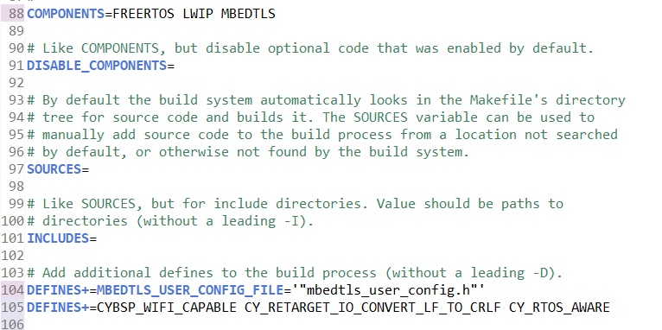
Configure the makefile
Add the following lines to your project's Makefile:
COMPONENTS=FREERTOS LWIP MBEDTLS
DEFINES+=MBEDTLS_USER_CONFIG_FILE=‘”mbedtls_user_config.h”’
DEFINES+=CYBSP_WIFI_CAPABLE CY_RETARGET_IO_CONVERT_LF_TO_CRLF CY_RTOS_AWARE
Note: There are blank COMPONENTS and DEFINES lines in the file that you can modify.

Slide 9
Main code
/*******************************************************************************
* Header Files
*******************************************************************************/
#include "cyhal.h"
#include "cybsp.h"
#include "FreeRTOS.h"
#include "task.h"
#include "wifi_config.h"
#include "cy_retarget_io.h"
#include "cy_wcm.h"
Add the following code into main.c
/*******************************************************************************
* Function Definitions
*******************************************************************************/
void wifi_connect(void *arg)
{
cy_rslt_t result;
cy_wcm_connect_params_t connect_param;
cy_wcm_ip_address_t ip_address;
uint32_t retry_count;
/* Configure the interface as a Wi-Fi STA (i.e. Client) and initialize the WCM. */
cy_wcm_config_t config = {.interface = CY_WCM_INTERFACE_TYPE_STA};
cy_wcm_init(&config);
printf("\nWi-Fi Connection Manager initialized.\n");
/* Configure the connection parameters for the Wi-Fi interface. */
memset(&connect_param, 0, sizeof(cy_wcm_connect_params_t));
memcpy(connect_param.ap_credentials.SSID, WIFI_SSID, sizeof(WIFI_SSID));
memcpy(connect_param.ap_credentials.password, WIFI_PASSWORD, sizeof(WIFI_PASSWORD));
connect_param.ap_credentials.security = WIFI_SECURITY;
/* Connect to the Wi-Fi AP. */
for (retry_count = 0; retry_count < MAX_WIFI_CONN_RETRIES; retry_count++)
{
printf("Connecting to Wi-Fi AP '%s'\n", connect_param.ap_credentials.SSID);
result = cy_wcm_connect_ap(&connect_param, &ip_address);
if (result == CY_RSLT_SUCCESS)
{
printf("Successfully connected to Wi-Fi network '%s'.\n",connect_param.ap_credentials.SSID);
break;
}
}
for(;;) {
//Enter code to handle LED
}
}
int main(void)
{
cy_rslt_t result;
/* Initialize the device and board peripherals */
result = cybsp_init() ;
if (result != CY_RSLT_SUCCESS)
{
CY_ASSERT(0);
}
/* Initialize retarget-io to use the debug UART port. */
cy_retarget_io_init(CYBSP_DEBUG_UART_TX, CYBSP_DEBUG_UART_RX, CY_RETARGET_IO_BAUDRATE);
__enable_irq();
printf("\x1b[2J\x1b[;H\n"); /* ANSI ESC sequence to clear screen. */
/* Create the WiFi connection task. */
xTaskCreate(wifi_connect, "wifi_connect_task", 1024, NULL, 5, NULL);
vTaskStartScheduler(); /* Never Returns */
for (;;)
{
}
}

Slide 10
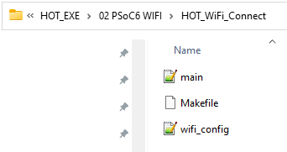
Copy and Edit files
Copy the 3 files (main.c, wifi_config.h and makefile) from …HOT_EXE\02 PSoC6 WIFI\HOT_WiFi_Connect into your root project directory.
Edit WIFI_SSID and WIFI_PASSWORD to join to your AP (mobile hot spot)
#define WIFI_SSID “MyHotSpot”
#define WIFI_PASSWORD “MyPassword”
#ifndef WIFI_CONFIG_H_
#define WIFI_CONFIG_H_
#include "cy_wcm.h"
/* SSID of the Wi-Fi Access Point to which the MQTT client connects. */
#define WIFI_SSID "xxxxxxxx"
/* Passkey of the above mentioned Wi-Fi SSID. */
#define WIFI_PASSWORD "xxxxxxxx"
/* Security type of the Wi-Fi access point. See 'cy_wcm_security_t' structure
* in "cy_wcm.h" for more details. */
#define WIFI_SECURITY CY_WCM_SECURITY_WPA2_AES_PSK
/* Maximum Wi-Fi re-connection limit. */
#define MAX_WIFI_CONN_RETRIES (10u)
/* Wi-Fi re-connection time interval in milliseconds. */
#define WIFI_CONN_RETRY_INTERVAL_MS (2000)
#endif /* WIFI_CONFIG_H_ */

Slide 11
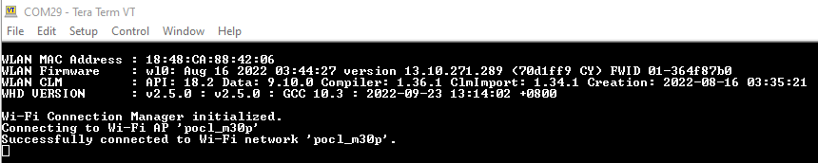
Built and Run the program
Build and run the program
Open Tera Term, 115200 baud rate, turn on mobile hot spot
Device will try up to 10 times to connect to network.
UART terminal display “Successfully connected to Wi-Fi network ‘my_network’ if device connects to network.

Slide 12
Secure TCP connection

Slide 13
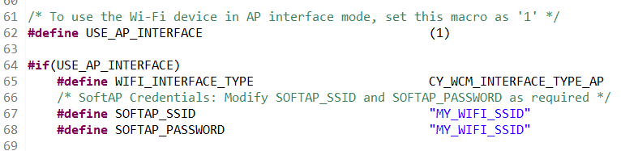
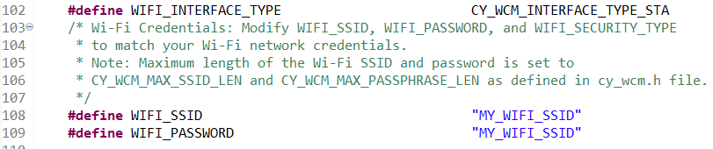
Secure TCP connection
Using a Secure TCP client and server example application to understand secure TCP connection implementation.
Find a partner. One to create new application “Wi-F Secure TCP server” and the other “Wi-Fi Secure TCP client”
For Secure TCP server, edit the following in network_credential.h
set #define USE_AP_INTERFACE to 1
edit #define SOFTAP_SSID
Edit #define SOFTAP_PASSWORD
Note: For TCP Server, please use a unique SSID. TCP Server also acts as access point.
For Secure TCP client, edit the following in network_credential.h
edit #define WIFI_SSID
Edit #define WIFI_PASSWORD to be the same as TCP server
Note: For TCP client, please match SSID to server
Build and program the boards. Open tera term (115200 baud rate)
Notes:
If everything works well, enter server ip address on client board via tera term.
Once connected, on server board, press user btn1 and can toggle led on client board

Slide 14
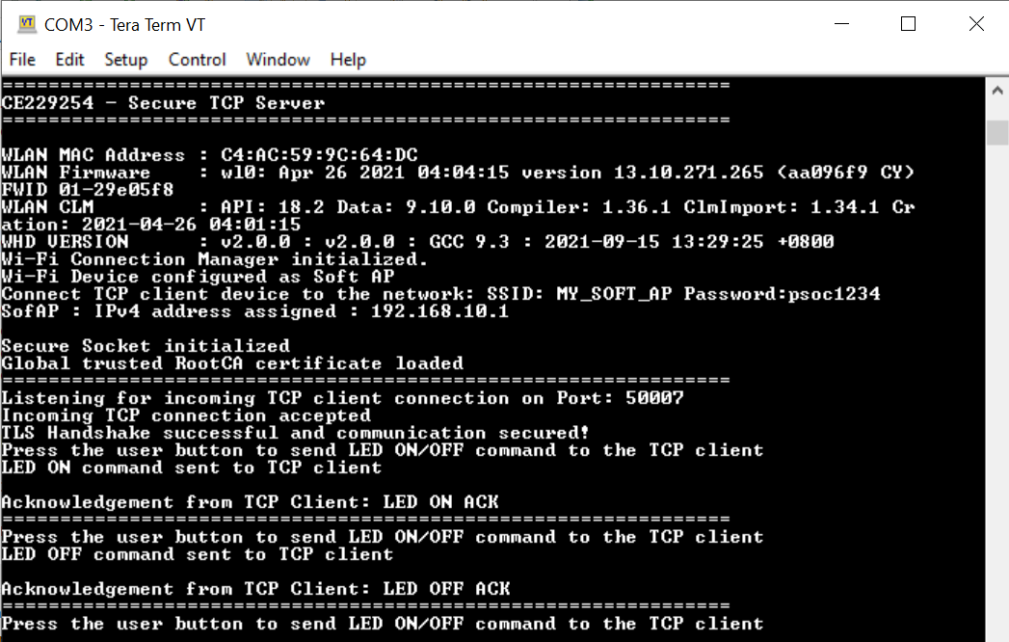
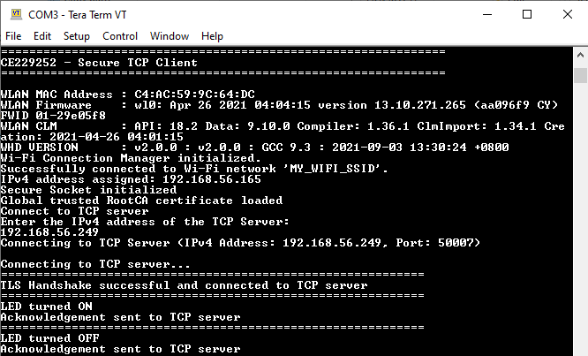
Results
TCP Server
Press the user button (CYBSP_USER_BTN) to send LED ON/OFF command to client.
Each user button press will issue the LED ON or LED OFF commands alternately. The client in turn sends an acknowledgement message back to the server.
TCP Client
Enter TPC Server address
On receiving LED ON/OFF command from server, client will ON/OFF LED and send acknowledgement message back to server.

Slide 15
Secure TCP client - One time (during initialization)
# | Step | Example
1 | Initialize the secure sockets library | cy_socket_init();
2 | Store the root certificate(s) via macros and create char arrays to reference them in your application. | #define SERVER_ROOTCA_PEM "..." static const char tcp_server_ca_cert[] = SERVER_ROOTCA_PEM;
3 | Store the client's certificate and private key via macros and create char arrays to reference them in your application (only if the server requires client certificate validation). | #define CLIENT_CERT_PEM "..." #define CLIENT_PRIVKEY_PEM "..." static const char tcp_client_cert[] = CLIENT_CERT_PEM; static const char client_private_key[] = CLIENT_PRIVKEY_PEM;
4 | Initialize a TLS Identity with the client’s certificate and the private key (only if the server requires client certificate validation) | cy_tls_create_identity (tcp_client_cert, strlen(tcp_client_cert),client_private_key, strlen(client_private_key), &tls_identity);
5 | Initialize the Root Certificate of the TCP server (only if you are going to validate the root certificate of the server – which you should always do to prevent MITM) | cy_tls_load_global_root_ca_certificates (tcp_server_ca_cert, strlen(tcp_server_ca_cert));

Slide 16
Secure TCP client – each time you want to send / receive data
# | Step | Example
1 | Create a Socket | cy_socket_create (CY_SOCKET_DOMAIN_AF_INET, CY_SOCKET_TYPE_STREAM,CY_SOCKET_IPPROTO_TLS, &client_handle);
2 | Enable TLS on the Socket | cy_socket_setsockopt (client_handle, CY_SOCKET_SOL_TLS, CY_SOCKET_SO_TLS_IDENTITY, tls_identity, sizeof(tls_identity));
3 | Set the TLS authentication mode – this can be one of the following three: CY_SOCKET_TLS_VERIFY_NONE CY_SOCKET_TLS_VERIFY_OPTIONAL CY_SOCKET_TLS_VERIFY_REQUIRED | cy_socket_tls_auth_mode_t tls_auth_mode = CY_SOCKET_TLS_VERIFY_REQUIRED; cy_socket_setsockopt(client_handle, CY_SOCKET_SOL_TLS, CY_SOCKET_SO_TLS_AUTH_MODE, &tls_auth_mode, sizeof(cy_socket_tls_auth_mode_t));
4 | Make the TCP connection | cy_socket_connect (client_handle, &address, sizeof(cy_socket_sockaddr_t));
5 | Write data | cy_socket_send (client_handle, message_buffer, strlen(message_buffer), CY_SOCKET_FLAGS_NONE, &bytes_sent);
6 | Read from the Stream (if you want to receive a response from the server) | cy_socket_recv (client_handle, message_buffer, TCP_LED_CMD_LEN, CY_SOCKET_FLAGS_NONE, &bytes_received);
7 | Disconnect | cy_socket_disconnect (client_handle, 0);
8 | Delete the Socket6 | cy_socket_delete(client_handle);

Slide 17
Secure TCP server – One time (during initialization)
# | Step | Example
1 | Initialize the secure sockets library | cy_socket_init();
2 | Initialize a TLS Identity with the server's certificate and the private key | cy_tls_create_identity(tcp_server_cert, tcp_server_cert_len, server_private_key, pkey_len, &tls_identity);
3 | Initialize the global trusted RootCA certificate. | cy_tls_load_global_root_ca_certificates (tcp_client_ca_cert, strlen(tcp_client_ca_cert));
4 | Create a Socket | cy_socket_create(CY_SOCKET_DOMAIN_AF_INET, CY_SOCKET_TYPE_STREAM, CY_SOCKET_IPPROTO_TLS, &server_handle);
5 | Set the socket to use the TLS identity. | cy_socket_setsockopt(server_handle, CY_SOCKET_SOL_TLS, CY_SOCKET_SO_TLS_IDENTITY, tls_identity, sizeof(tls_identity));
6 | Set the TLS authentication mode | cy_socket_tls_auth_mode_t tls_auth_mode = CY_SOCKET_TLS_VERIFY_REQUIRED; cy_socket_setsockopt(server_handle, CY_SOCKET_SOL_TLS, CY_SOCKET_SO_TLS_AUTH_MODE, &tls_auth_mode, sizeof(cy_socket_tls_auth_mode_t));
7 | Bind the TCP socket created to your server IP address and TCP port | cy_socket_bind(server_handle, &tcp_server_addr, sizeof(tcp_server_addr));
8 | Listen on the socket for incoming connection requests | cy_socket_listen(server_handle, TCP_SERVER_MAX_PENDING_CONNECTIONS);

Slide 18
Secure TCP server – each time you want to setup and accept a connection
# | Step | Example
1 | Accept connection | cy_socket_accept(server_handle, &peer_addr, &peer_addr_len, &client_handle);
2 | Read from the connection | cy_socket_recv(server_handle, message_buffer, MAX_TCP_RECV_BUFFER_SIZE, CY_SOCKET_FLAGS_NONE, &bytes_received);;
3 | Write a response | cy_socket_send(server_handle, &message, strlen(message), CY_SOCKET_FLAGS_NONE, &bytes_sent);
4 | Disconnect the Socket | cy_socket_disconnect(server_handle, timeOut);

Slide 19
MQTT via Mosquitto broker

Slide 20



Objective
Understand the concept of public key cryptography
To generate key pairs and certificate signing request
Review the code for MQTT connection.
client.key
CA
cert
https://test.mosquitto.org/
Client
cert
ClientCSR
Return command to toggle LED when button 1 is pressed
Wi-Fi Access Point
Connection update to PC

Slide 21
Edit wifi_config.h
Create a new WiFi_MQTT_Client application
Use your mobile hotspot as access point. Edit “wifi_config.h” to match your mobile SSID setting
#define WIFI_SSID “mobile_ssid”
#define WIFI_PASSWORD “password”

Slide 22
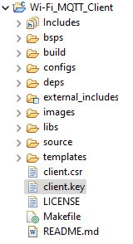
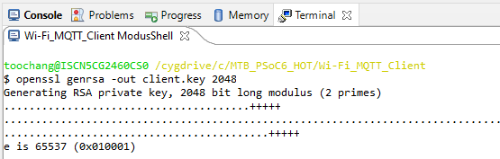
Generate Client key
Run the following commands with Terminal
to generate the Client key (Client.key).
openssl genrsa –out client.key 2048

Slide 23
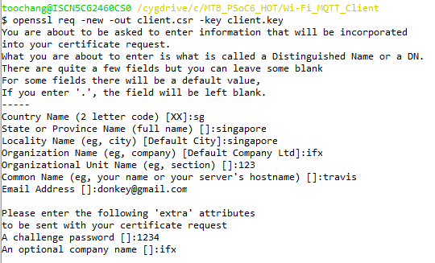
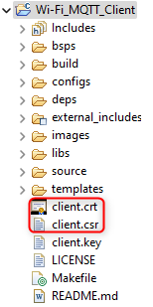
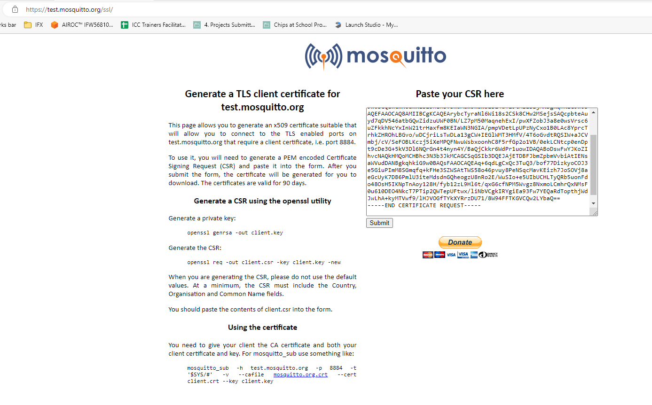
Generate Client Certificate
Generate the Client certificate (client.csr) with the following commands
openssl req –out client.csr –key client.key –new
Enter info required for the certificate signing request
Open client.csr, copy and paste content to https://test.mosquitto.org/ssl/
Save the generated client certificate into the project root folder

Slide 24
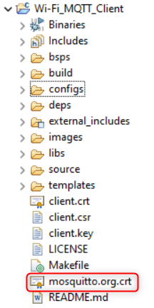
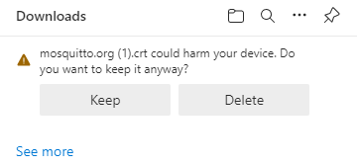
Download CA certificate
Download CA certificate from http://test.mosquitto.org/ssl/mosquitto.org.crt and save it to project root folder

Slide 25
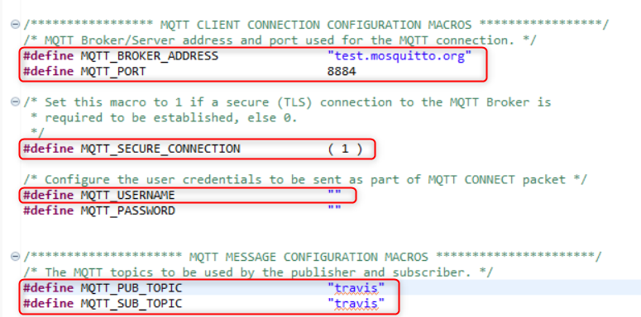
Edit file mqtt_client.h
Edit the following in “configs/mqtt_client.h”
MQTT_BROKER_ADDRESS to “test.mosquitto.org”
Set the macros MQTT_PORT to 8884
MQTT_SECURE_CONNECTION to 1
MQTT_USERNAME to “”
MQTT_PUB_TOPIC to “unique_topic”
MQTT_SUB_TOPIC to “unique_topic”
MQTT_SNI_HOSTNAME to “test.mosquitto.org”
Use your own name

Slide 26
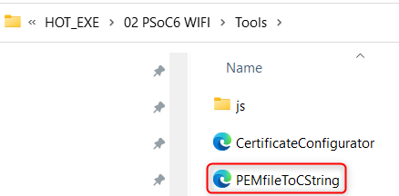
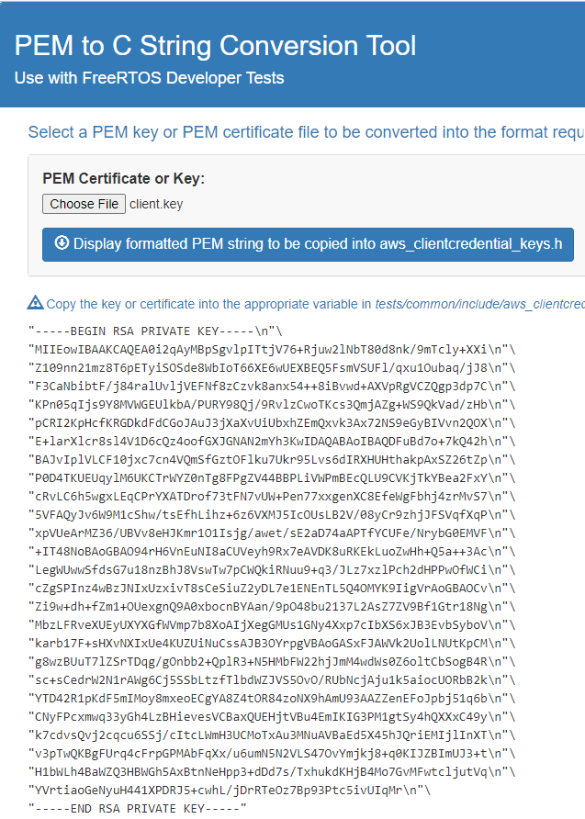



Edit file mqtt_client.h
Open the PEMfileToCstring
Use PEM to C String Conversion Tool to generate data format and copy to appropriate define in “configs/mqtt_client_config.h”
client.crt -> #define CLIENT_CERTIFICATE
client.key -> #define CLIENT_PRIVATE_KEY
mosquitto.org.crt -> #define ROOT_CA_CERTIFICATE
1
2
client.crt
client.key
mosquitto.org.crt

Slide 27
Build and run the program
Build and program. Open Tera Term, baud rate 115200
Press user button
The GPIO interrupt service routine (ISR) notifies the publisher task.
The publisher task publishes a message on a topic.
The MQTT broker sends back the message to the MQTT client because it is also subscribed to the same topic.
When the message is received, the subscriber task turns the LED ON or OFF. As a result, the user LED toggles every time the user presses the button.

